Slide 1

Faculty of Mechanical Engineering
Seminar Presentation
Autonomous Parking of an Articulated Vehicle using End-to-End Reinforcement Learning
Presented by:
Amirhossein Mohammadi
Supervisors:
Dr. Shahram Azadi
Dr. Reza Kazemi

Slide 2



Table of Contents
Introduction
Background and Motivation
Approaches to Self-Driving
Sensors
Modeling and Formulation
Methodology
Machine Learning / Deep Learning Recap
Reinforcement Learning
Conclusion
Literature Review

Slide 3
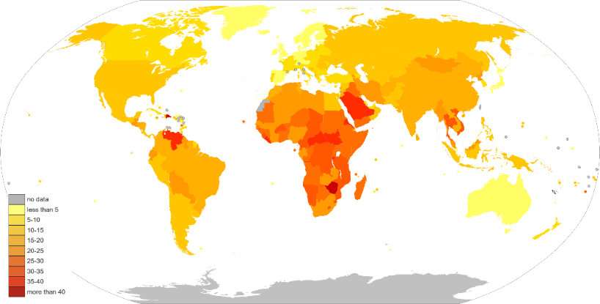
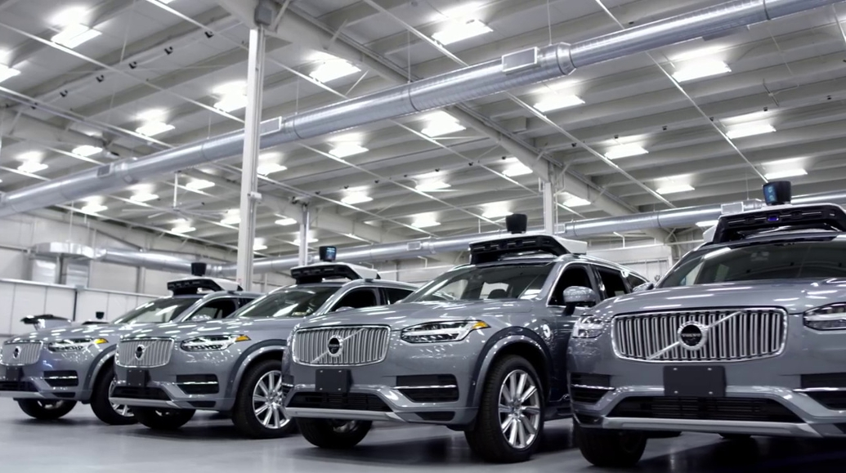

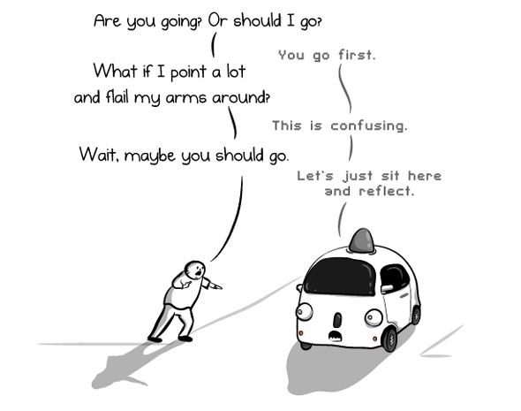
Background and Motivation
Benefits
Lower risk of accidents
Providing mobility for elderly and people with disabilities
Pollution decrease
New ways of public transportation
Reducing number of cars (95% of the time a car is parked)
Challenges: Self-Driving is difficult.
Snow, heavy rain, night
Unstructured roads, parking lots
Pedestrians, erratic behavior
Reflections, dynamics
Rare and unseen events
Merging, negotiating, reasoning
Ethics and legal considerations
Generalization and Robust Performance

Slide 4
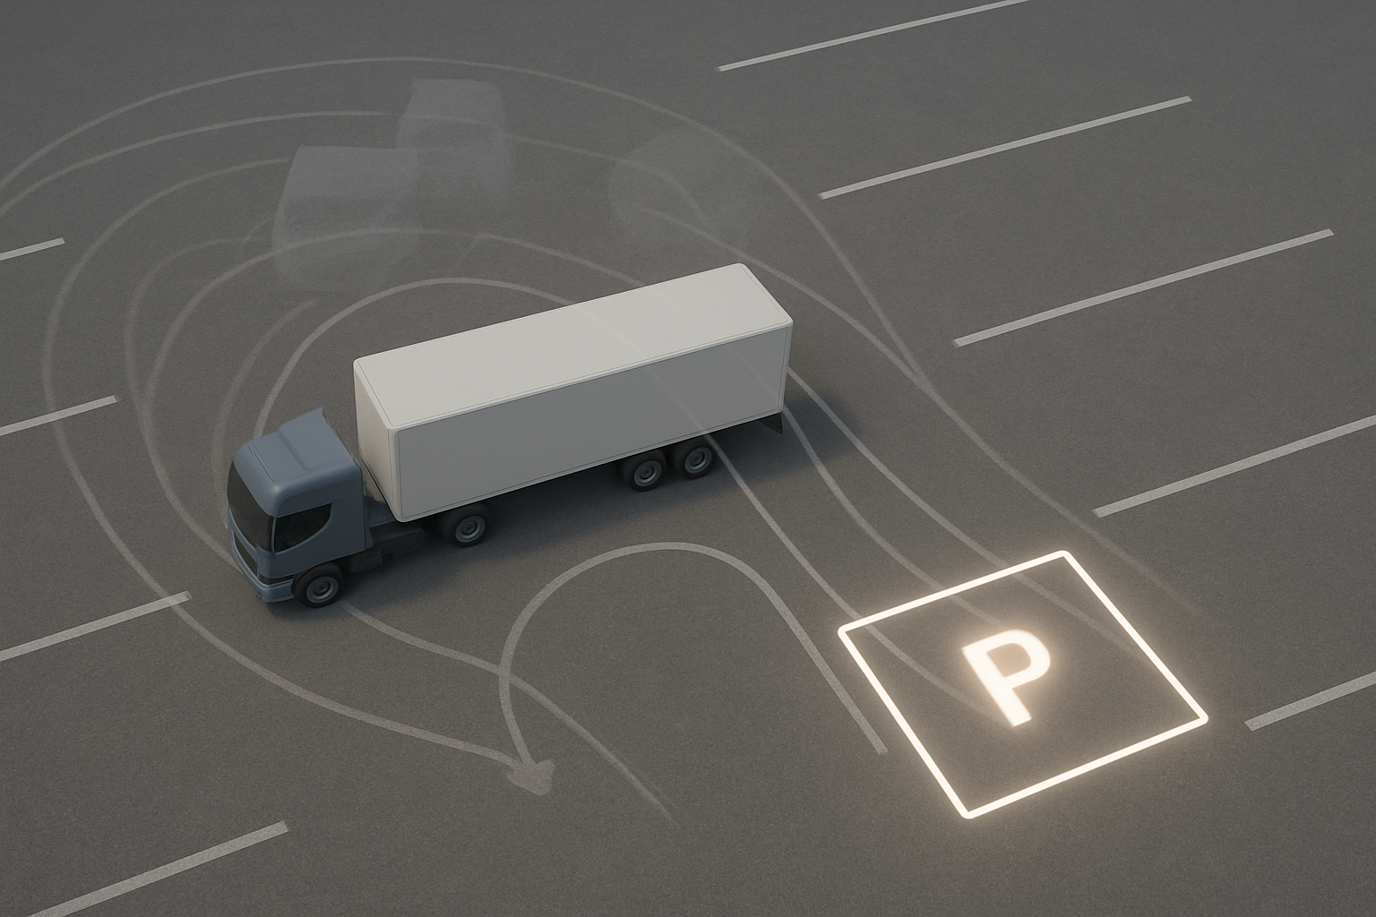
Background and Motivation
The most difficult task in driving is Parking
Large Dimensions
Limited Reverse Maneuvering
Blind Spots
Degrees of Freedom
Non-Holonomic Constraints

Slide 5
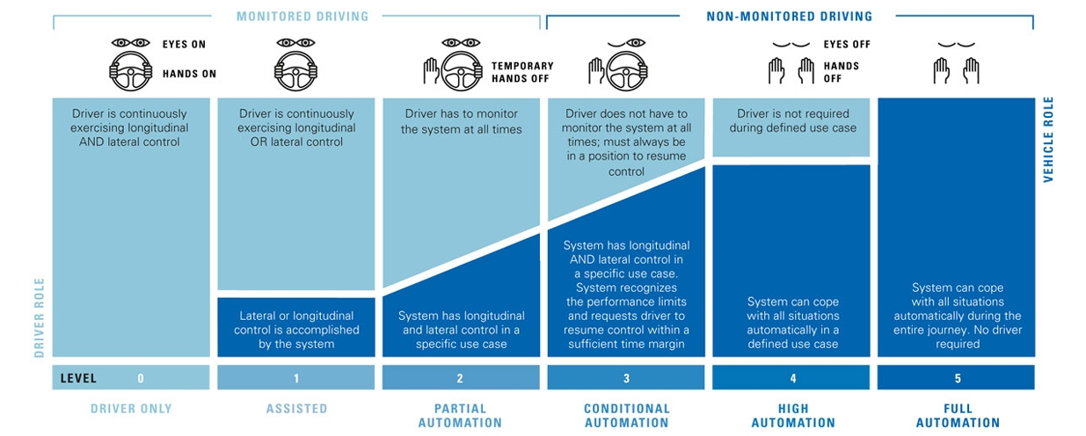
Background and Motivation
SAE Levels of Autonomy for Automated Driving Systems (ADS)

Slide 6
Literature Review
Title | Author | Year
ALVINN: An Autonomous Land Vehicle in a Neural Network | Pomerleau, Dean A. | 1988
Autonomous Docking and Parking of Articulated Mobile Robots | Delrobaei, M. | 2010
Automatic Parking of an Articulated Vehicle Using ANFIS | Azadi, Sh., et al. | 2013
Autonomous Parking for Articulated Vehicles | Kusumakar, R. | 2017
Reinforcement Learning-Based Motion Planning for Automatic Parking System | Zhang, J., et al. | 2020
Survey of Deep Reinforcement Learning for Motion Planning of Autonomous Vehicles | Aradi, S. | 2022
End-to-end Autonomous Driving: Challenges and Frontiers | Chen, Li., et al. | 2023

Slide 7
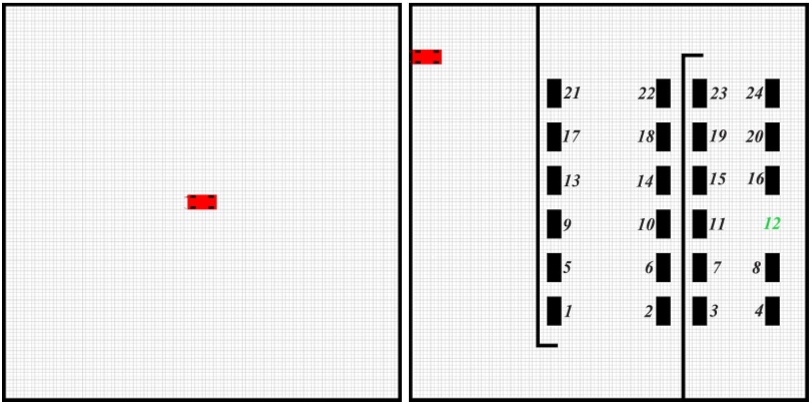
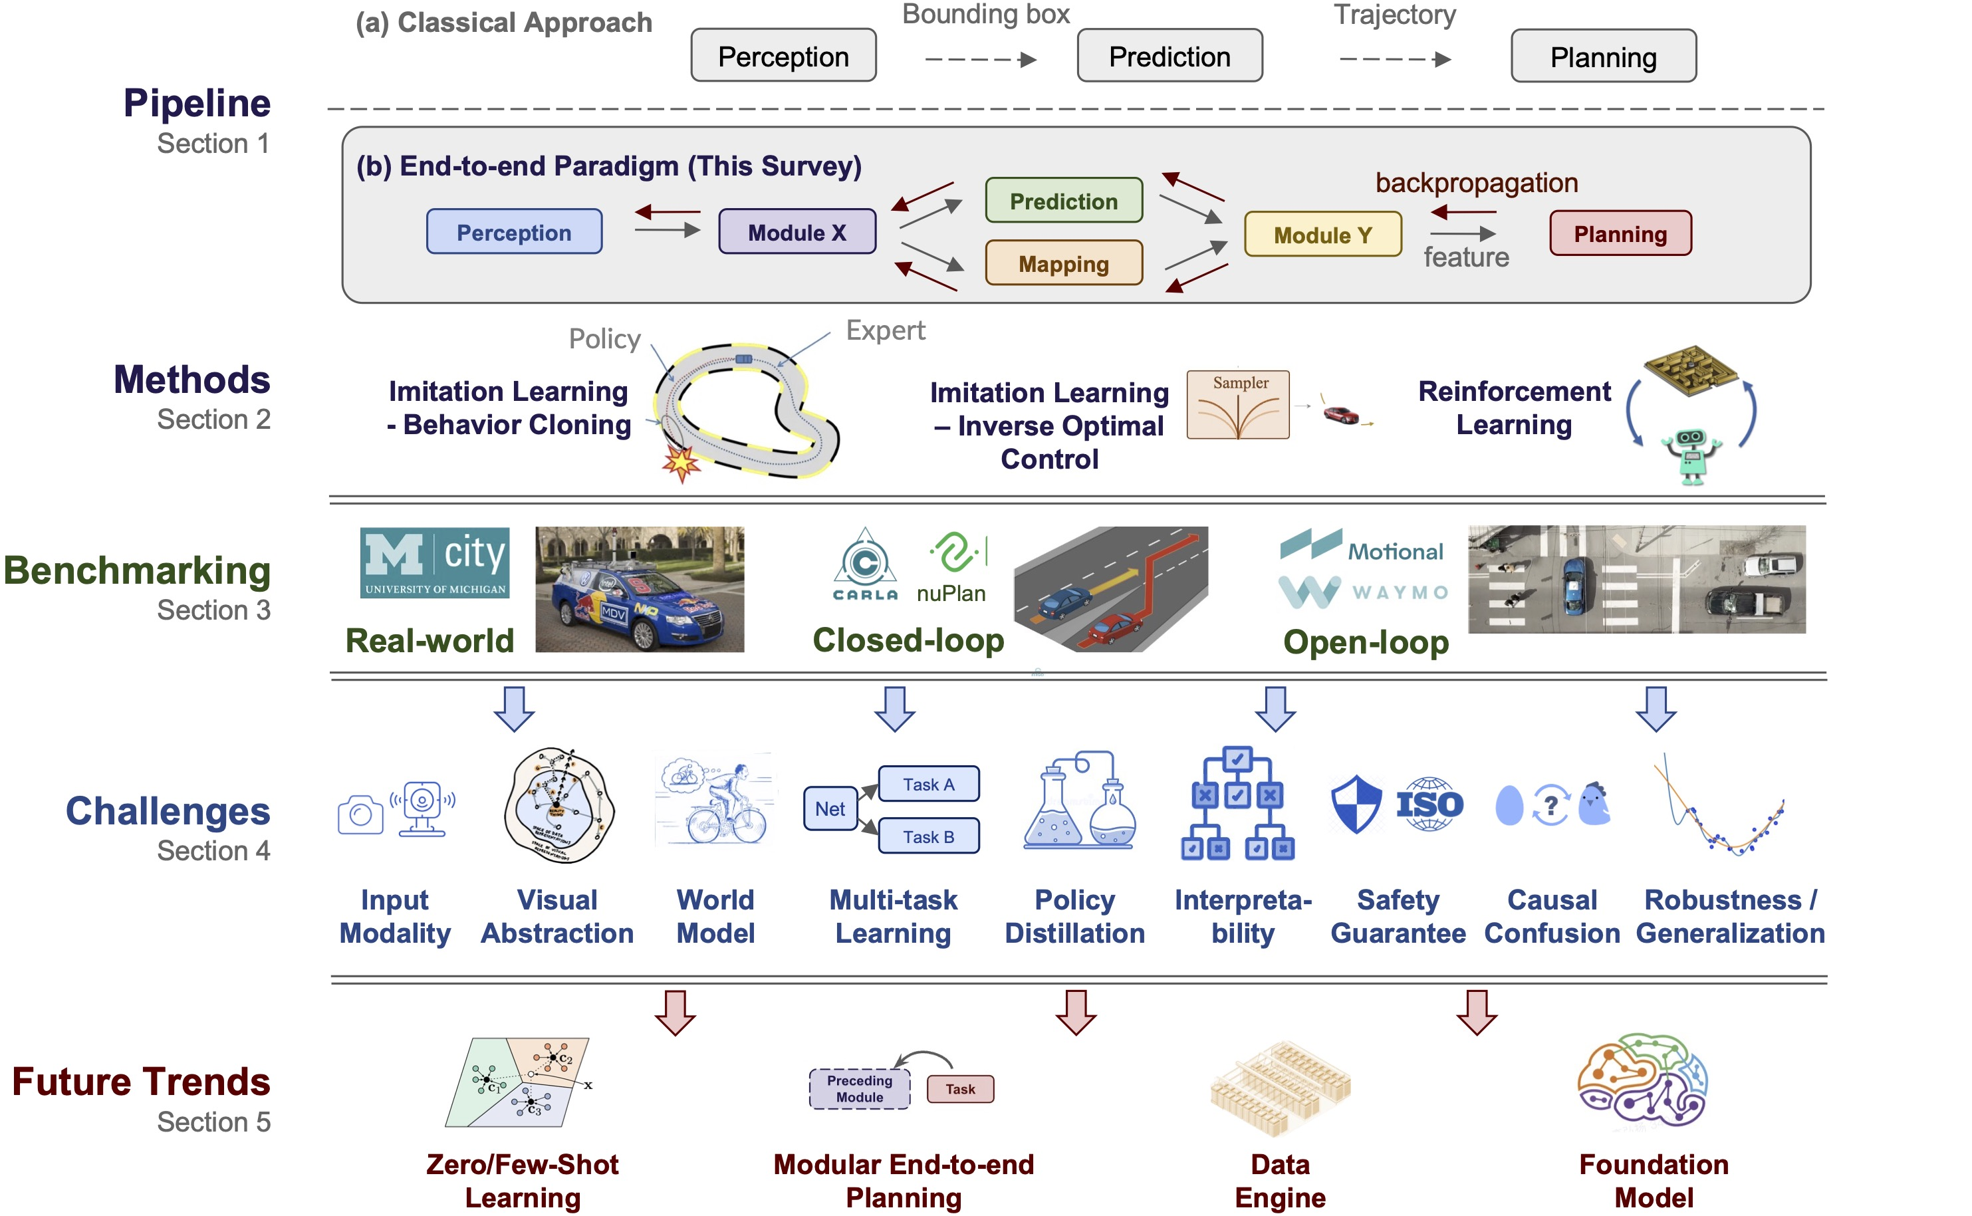
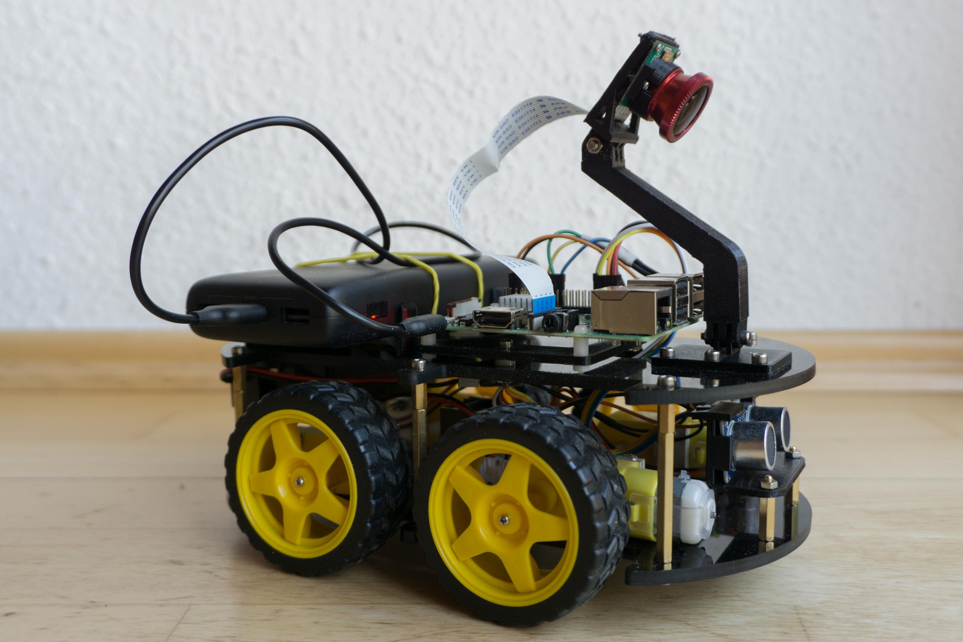
Literature Review: Open-Source Projects

Slide 8
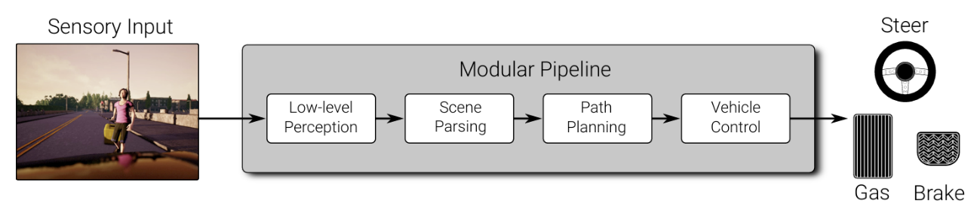
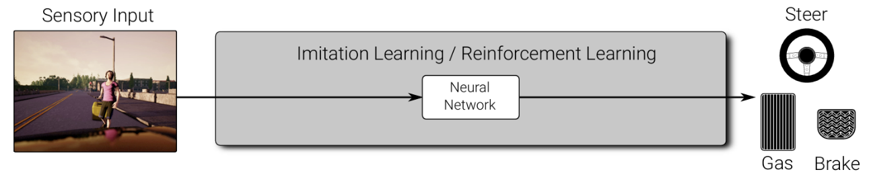
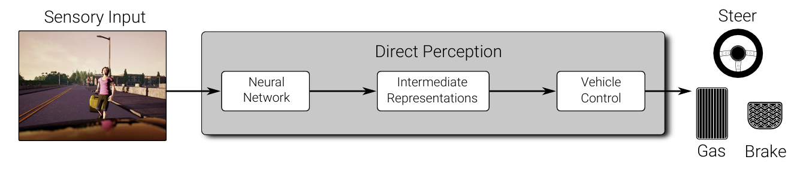
Approaches to Self-Driving
Modular Pipeline
End-to-End Learning
Direct Perception
Pros
Small components, easy to develop in parallel
Interpretability
Theoretical Stability
Cons
Piece-wise training (not jointly) Localization and planning
Heavily relies on HD maps
Pros
End-to-End training (Main Objective)
Cheap annotations
Easy for Implementation
Cons
Training / Generalization
Interpretability
Pros
Compact Representation
Interpretability
Cons
Control typically not learned jointly
How to choose representations?

Slide 9
Sensors
Sonar
Radar
Lidar
Camera

Slide 10
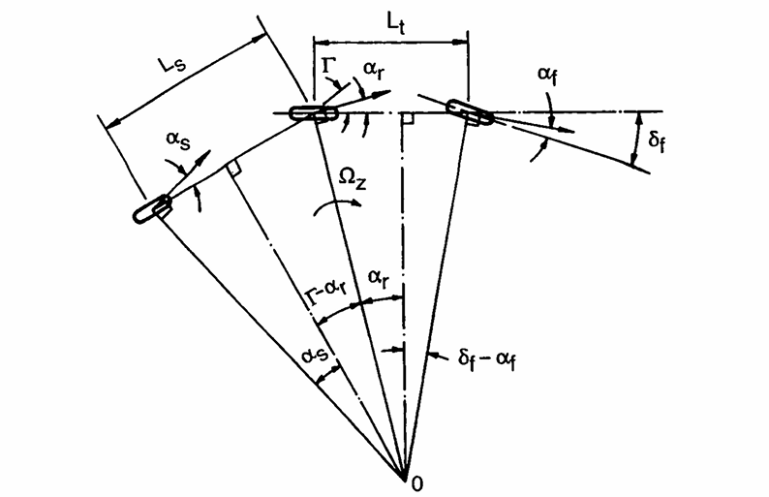
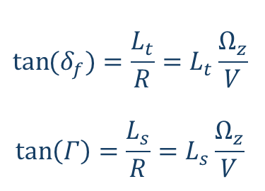
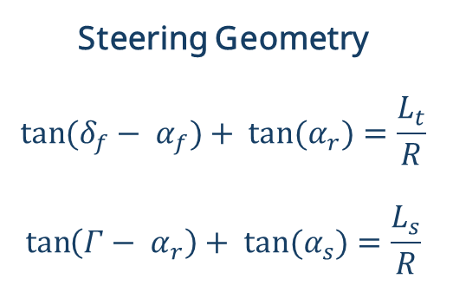
Modeling: Kinematics
Assumptions:
Low Speed: Rigid Tires and No Slip
Steady State Cornering
Single Instantaneous Center of Rotation
Large Yaw Radius
Fifth wheel is on top of the rear tractor axis
Steering Geometry
$$\tan{(δ_{f}− α_{f})+ tan⁡(α_{r})=\frac{L_{t}}{R}}$$
$$\tan\left(Γ− α_{r}\right)+ tan⁡(α_{s})=\frac{L_{s}}{R}$$
$$\tan{(δ_{f})=\frac{L_{t}}{R}}=L_{t}\frac{Ω_{z}}{V}$$
$$\tan\left(Γ\right)=\frac{L_{s}}{R}=L_{s}\frac{Ω_{z}}{V}$$

Slide 11
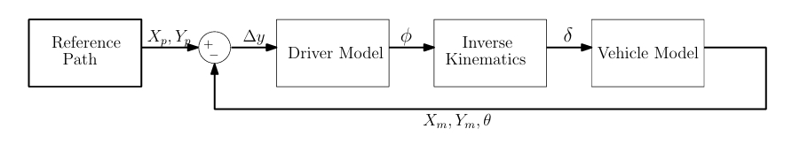
Modeling: Inverse Kinematics
Inputs
Steering Angle
Velocity
Direct Kinematics
Desired Outputs
Yaw Rate
Articulation Angle
Inverse Kinematics

Slide 12
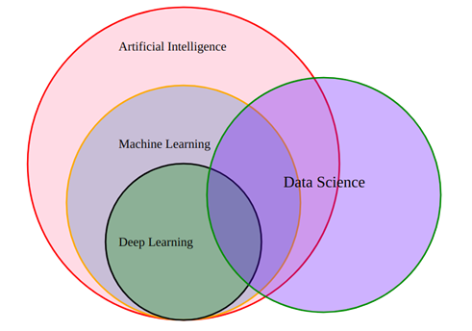
Methodology: Machine Learning
Machine Learning is great for:
Problems with a lot of hand-tuning or long lists of rules
Complex problems for which there is no good solution at all using a traditional approach
Fluctuating environments: a Machine Learning system can adapt to new data.
Getting insights about complex problems and large amounts of data.

Slide 13
Methodology: Machine Learning
Machine Learning Algorithms
Supervised Learning
Unsupervised Learning
Reinforcement Learning
Regression
Classification
Clustering
Semi-Supervised Learning

Slide 14
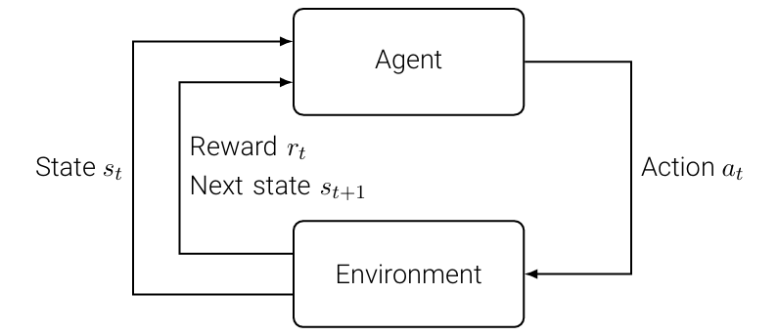
Methodology: Reinforcement Learning
Process
Agent observes environment state at time t.
Agent sends action at time t to the environment.
Environment returns the reward/penalty and its new state to the agent.
Objective
Learning the best policy to maximize total future rewards

Slide 15
Methodology: Reinforcement Learning
Pros
End-to-End Control Algorithm
No dataset is required.
Future Based Decision Making
Real-world Loss Functions
Cons
Heavy simulations
Complex Theory
Markov Decision Process
Bellman Optimality
Deep Q Learning

Slide 16
Conclusion
Foundation Established
Problem Contextualized: Statement, Challenges and innovations
Theoretical Core Defined: Simplified Kinematics and Inverse Kinematics
Methodology Selected: End-to-End Machine learning and Reinforcement Learning
Future Work
Coding the foundations using Python and OpenAI Gymnasium
Advanced Programming in Python, Pytorch and Real-World Simulations using Carla
Completion of the Thesis
Implementation and Experimenting on an Articulated Mobile Robot

Slide 17
Thank you

